Slide 1
The Development of a Role-Playing Game for The Android Operating System

Slide 2




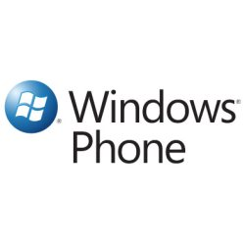
Mobile Operating Systems
Apple (iOs) – iPhones & iPads
Blackberry (RIM) – BlackBerry Phone & BlackBerry Tablet
Nokia (Symbian) – Nokia Smart Phones
Samsung (Bada) – Samsung Smart Phones & Tablets
Windows Phone – Smart Phones

Slide 3
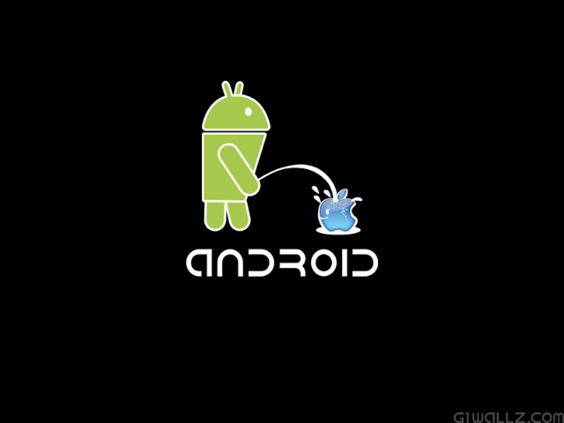
Android Operating Systems
Programmed in C, C++, & Java
Open Sourced (Apache 2.0 and GPLv2)
Founded October 2003
Initial release: September 23, 2008
Latest Release: 4.1 Jelly Bean

Slide 4
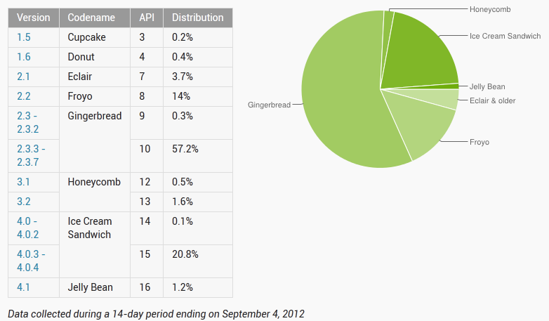
Android OS Releases

Slide 5

Why Android?
Forward-Compatible: Anything written for an older Kernel (ie. Gingerbread) will work for any Kernel release after Gingerbread.
Price: There is a wide range of prices for Android phones
Open Sourced: The source code is available to make modifications.
Runs Java (Which we will be using to build our project)

Slide 6
Android Applications
Android App Market: Google Play
Cost nothing to develop an application.
  Other markets force you to buy a product before you can start developing your application.
Development Language: Java
Mobile OS | Android | iOS | RIM | Symbian
Market | Google Play | Apple Market | Black Berry | Nokia Suite
Initial App Store Fee's | $25.00 One time fee | $99.00 per year | $100.00 One time fee | $73.00 One time fee
Free Apps | Free | Free | Free | Free
Paid Apps | 30% of profit | 30% of profit | 20% of Profit | 30% or Profit

Slide 7
Mobile Gaming
Snake (1997) was the first mobile game.
In between 1997 – 2007, mobile gaming was not a successfully stable.
In 2007, the first generation of iPhones brought mobile gaming to life again.
As smart phones became more “smart,” gaming followed right behind.
With 3D graphics, high resolution screens, and 4G network speeds, gaming was reinvented.
Angry Birds was initially released December 2009 for iPhones.

Slide 8
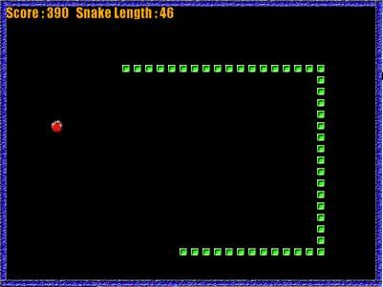
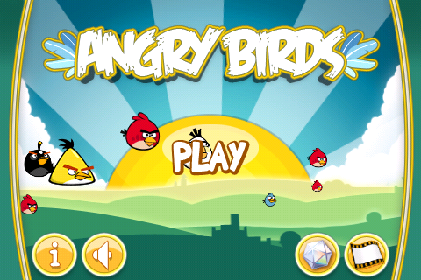
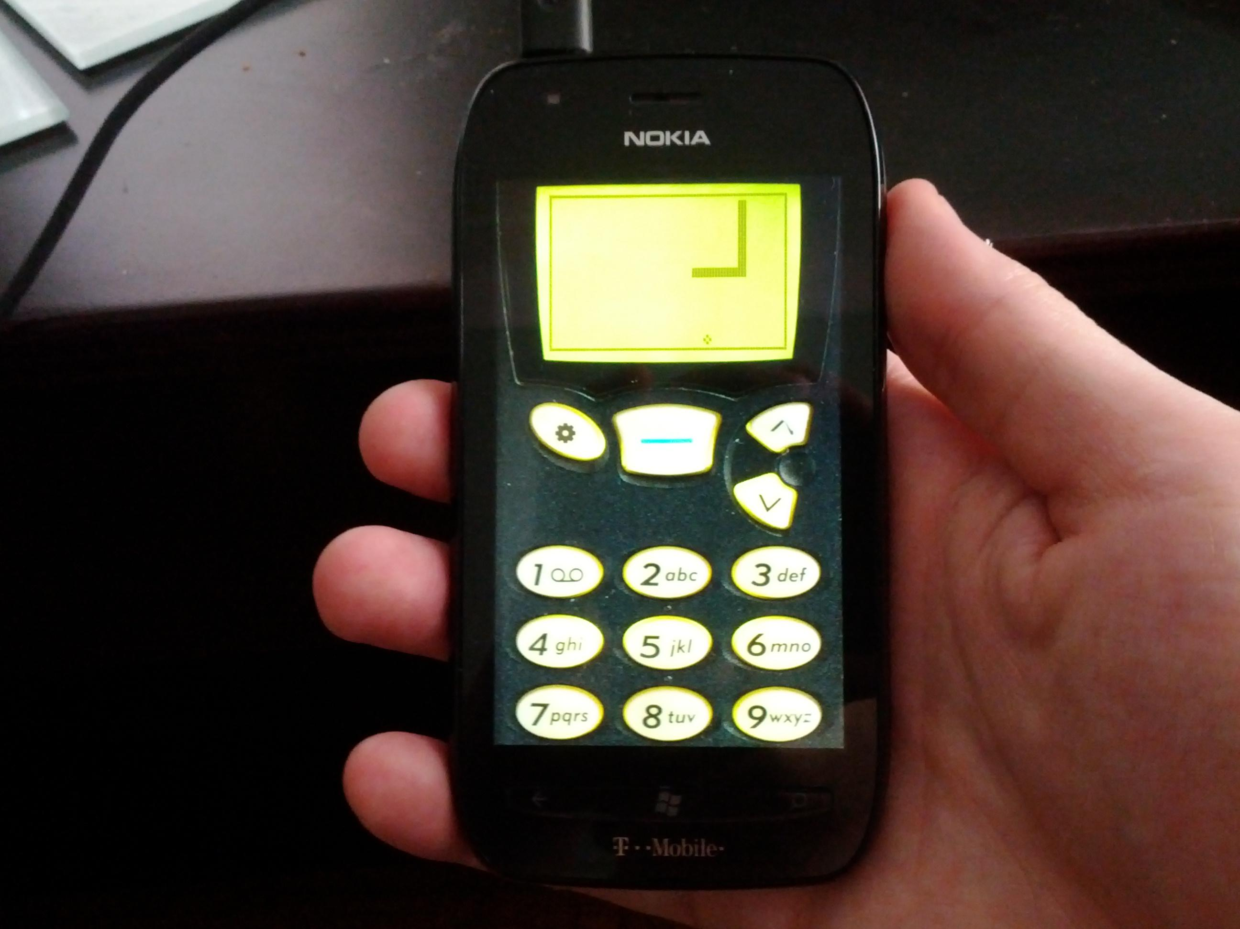
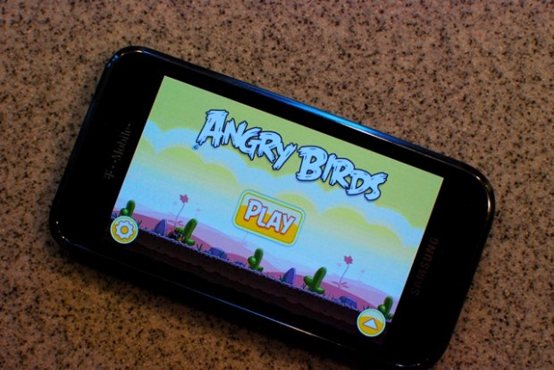

Slide 9

RPG (Role-Playing Game)
Free roam
Different experience for every player
Decision making
Character personalization
Extended game-play

Slide 10
Our Game
Dungeon crawler
Main and side quests
Hero will level up, gain new abilities and get access to better weapons to defeat his enemies.
New items will become available to the hero after completing quests.
Main quest will be saving the town's people that were captured by the antagonist.

Slide 11

Concept Art
Our Hero

Slide 12
Project Time line
By October 2nd:
Main map designed
UI prototype
Quest & stories designed
By October 16th:
Map drawn out
UI finalized
List of items
Graphics engine prototype
By October 30th:
Loadable game
UI implemented
Coding
By November 13th:
Main quest finalized and runnable
Characters fully developed
Items implemented
Game runnable
By November 27th:
Game fully functional
Side quests added
Performance tweak
Finished

Slide 13
References
http://developer.android.com/about/dashboards/index.html
http://www.bitrebels.com/technology/the-complete-android-history-timeline-infographic/
http://mobiledevices.about.com/od/additionalresources/bb/Before-You-Become-A-Freelance-Mobile-App-Developer.htm
http://articles.businessinsider.com/2011-08-21/tech/30035291_1_mobile-gaming-n-gage-competitive-online-gaming

